Slide 1

Southern Water Corp. Descriptive Stats
Mehmet Tiras-May/2020

Slide 2
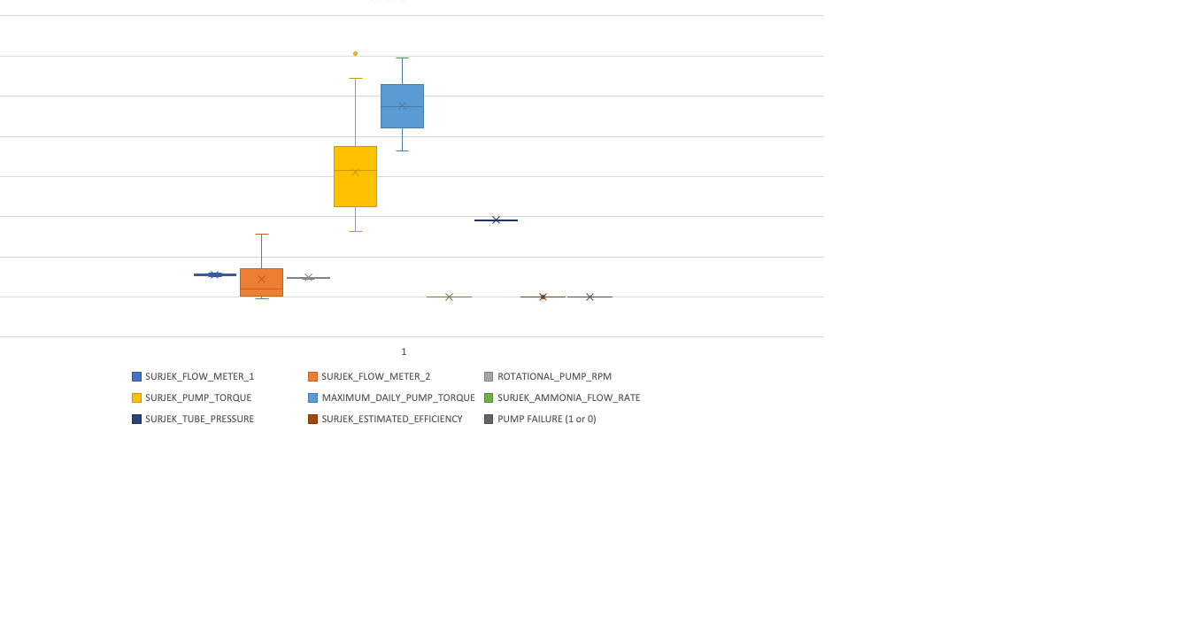

Slide 3
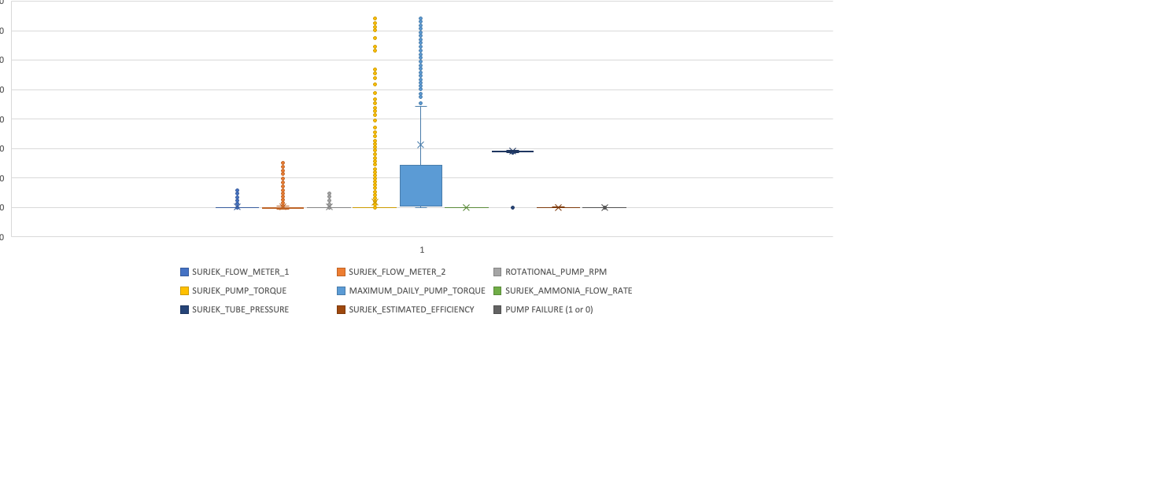

Slide 4
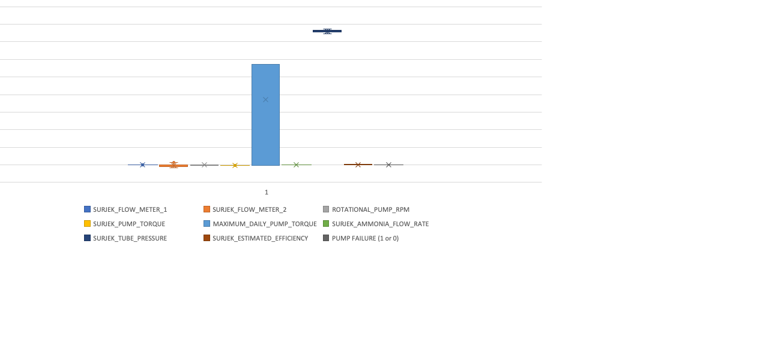

Slide 5
